Slide 1
Telemedicine: Indian National & Institutional Perspective
Track: Digital Health Trends
Prof. S K Mishra, MS, FACS
Head, Dept. of Endocrine Surgery &
Faculty I/C, SGPGI Telemedicine Programme
Sanjay Gandhi Postgraduate Institute of Medical Sciences (SGPGIMS) Lucknow, India
Email: skmishra@sgpgi.ac.in or skmishra_1956@yahoo.com
www.nmcn.in

Slide 2
Agenda
Evolution of Indian Telemedicine Programme
Current Policy of Telemedicine & Digital Health
Major ongoing National Programmes
Bridging with Digital Health
Institutional Initiative at SGPGI, National Resource Center
Future Perspective of collaboration

Slide 3
Evolution : Agency Involved
Department of Information Technology (DIT)
Institution Level
Government
Department of Space (DoS)
Indian Space Research Organisation (ISRO)
Corporate
Department of Health and Family Welfare

Slide 4
Current Policy
elearning: National Medical College Network (NMCN)
Telemedicine: Health & Wellness Network
Standardisation of EMR
Promotion of IT in health services: eHospital, ePharmacy, myHealthRecord, Maternal & Child Health

Slide 5
Major National Programs

Slide 6
NATIONAL MEDICAL COLLEGE NETWORK (NMCN)
50 Govt. Medical Colleges having National Knowledge Network (NKN) networked for Tele-CME, Tele-specialist consultations and Access to Digital Library etc.
INFRASTRUCTURE SETUP
Creation of following facilities at Medical College
Tele-consultation Facility
Digital Medical Lecture Theatre
E-Learning and Digital Library
OBJECTIVES
Tele-Consultation
Tele-Follow ups
EHR Creation of Patients
Remote Mentoring
Creating Learning Resources

Slide 7
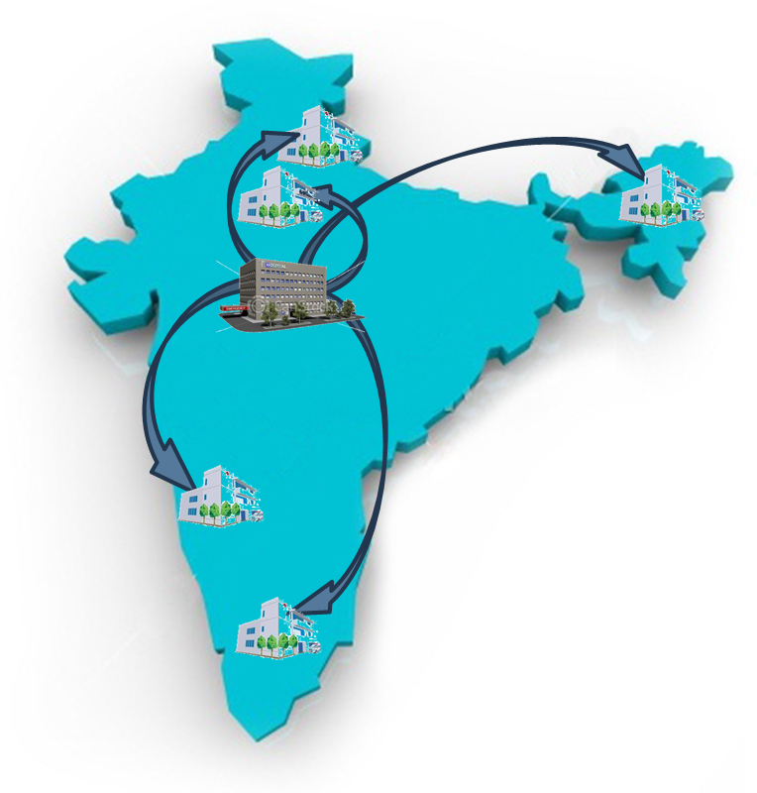
NATIONAL MEDICAL COLLEGE NETWORK (NMCN)
Scalable , Hierarchal, Secured IPv6 compatible Network Riding over NKN
 | Region | Medical College | State
I | National Resource Centre | SGPGI, Lucknow, UP | Uttar Pradesh, Odisha
II | Regional Resource Centers
i. | Northern Region | PGIMER, Chandigarh | Chandigarh, Himachal Pradesh, Haryana, J&K and Punjab
ii. | Southern Region | JIPMER, Pondicherry | Puducherry, Andhra Pradesh, Telangana and Tamil Nadu
iii. | Eastern Region | IMS, BHU, Varanasi, U.P. | Bihar, Jharkhand, West Bengal and A&N islands
iv. | Western Region | KEM Medical College &Hospital, Mumbai, Maharashtra | Maharashtra, Gujarat, Goa, Daman &Diu , Dadra & Nagar Haveli
v. | Central Region | AIIMS, New Delhi | Delhi, Chhattisgarh, Madhya Pradesh, Rajasthan, and Uttarakhand
vi. | North-eastern Region | NEIGRIHMS, Shillong, Meghalaya | Meghalaya, Assam, Manipur, Tripura, Nagaland, Sikkim, Mizoram & Arunachal Pradesh
vii. | Southern Region | Government Medical College, Trivandrum, Kerala | Kerala, Karnataka and Lakshadweep
01 National Resource Center
07 Regional Resource Centers
42 Medical Colleges
29 States/UTs
7500 student at a time

Slide 8
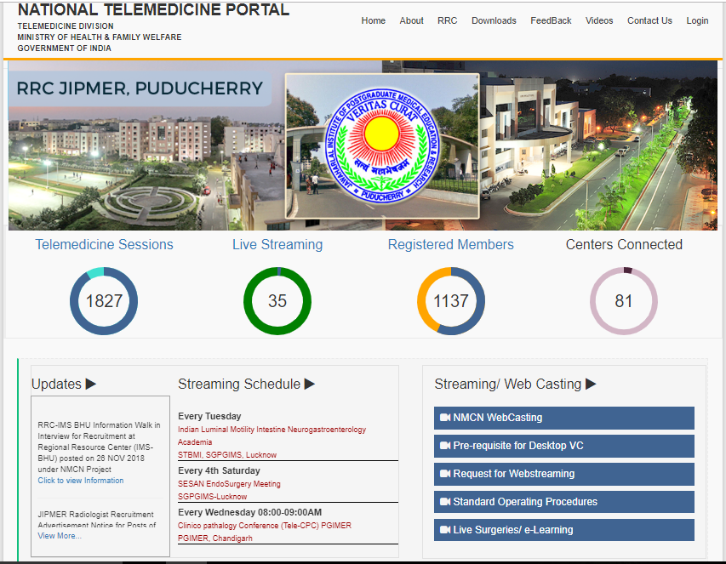
lectures being transmitted using NMCN project within 50 Medical Colleges
Live Interaction through VC and Live Streaming Mode using website www.nmcn.in
OPERATIONS OVERVIEW

Slide 9
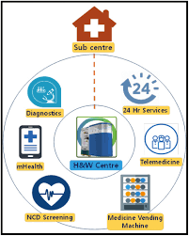
New Vision For Primary Health Care Health & Wellness Center (HWC)
Screening and early detection of NCDs
Package of 12 essential services
Integrate AYUSH, Yoga, Diet Modification, Lifestyle Change
Monthly Dispensing of Drugs
Point of Care Diagnostics
IT system to enable continuum of care
Health and Wellness Centres: Team (1:5000)
1 Bridge Course Trained Mid-level provider (Nurse Practitioner/ Ayurveda Practitioner)
2 Multi-purpose workers: M/F
5 ASHAs
PHCs: Doctor led team
FRU: At CHC/SDH/ DH
Leverage support from MPLADS/MGNREGA/Philanthropy/CSR Voluntarism

Slide 10
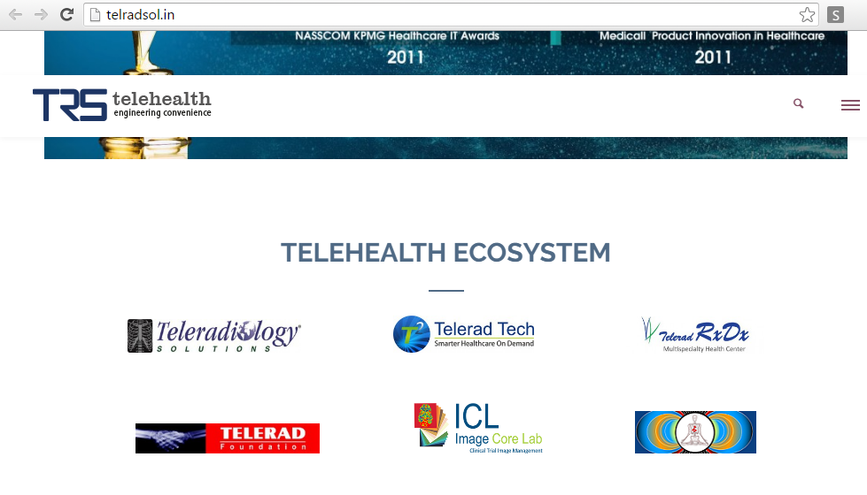
Tele-Radiology
20

Slide 11
Knowledge Engineering Infrastructure: SGPGI Case Study
Institutional Perspective

Slide 12
Technical Infrastructure
Video Conference Suites (Point to Point & Point to Multi-point)
Integrated Networked Lecture Theatre/ Auditorium
Surgical Telepresence Suite
Digital, Integrated Operation Theatre
Desktop Videoconference Enterprise
Mobile Telemedicine Kiosk
Telemedicine Network Operating Center
Studio
Knowledge Processing Edit/Voice Over
Medical Data Center
Advance Multimedia & Animation Lab

Slide 13
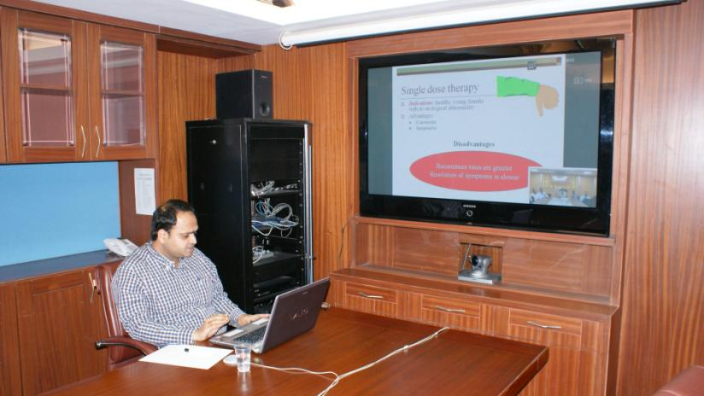
Point to point Video Conferencing Suite

Slide 14
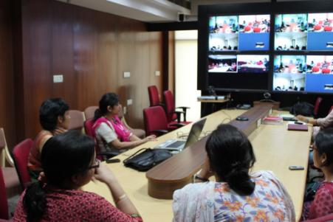
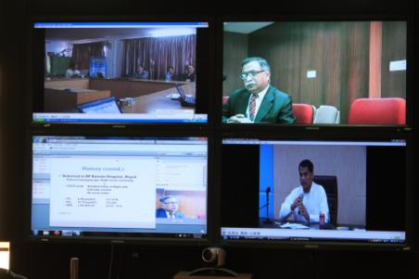
Point to Multipoint Video conferencing Suite
Dept. of Medical Genetics in Multi party session
Ongoing conference using TEIN Network with Nepal & Thailand

Slide 15
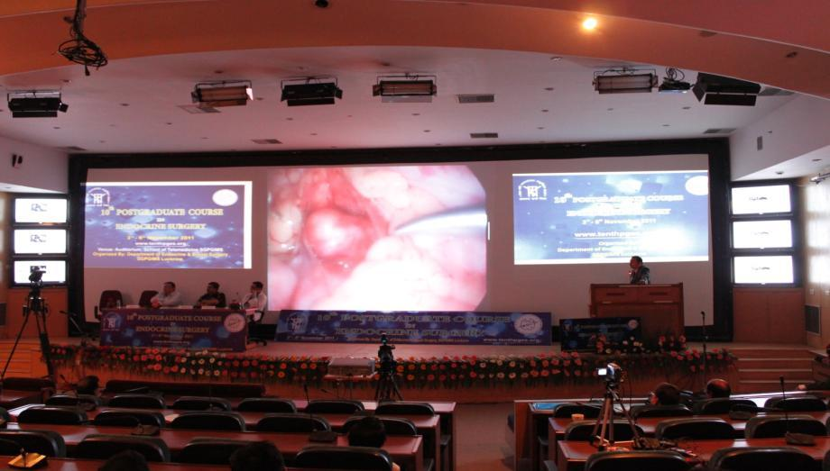
Integrated Networked Lecture Theatre/ Auditorium

Slide 16
Production Control Room & Master control Room

Slide 17
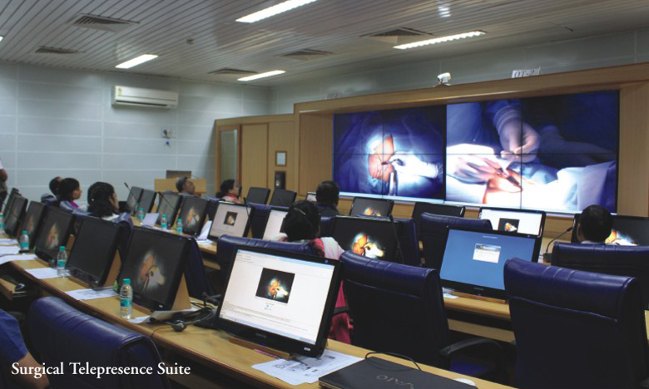
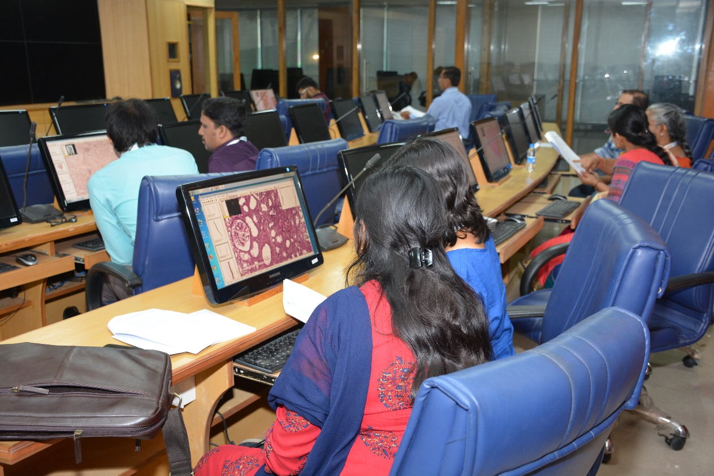
Surgical Telepresence Suite

Slide 18
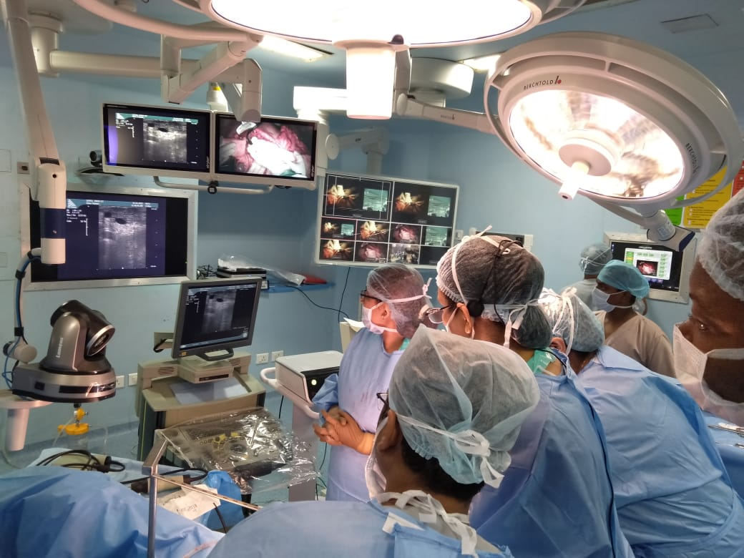
Digital Integrated Operation Theatre

Slide 19
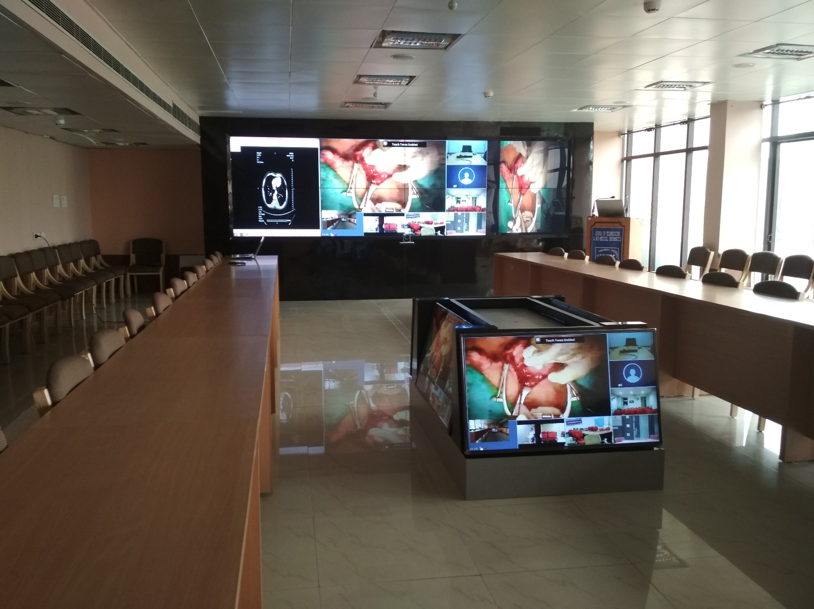
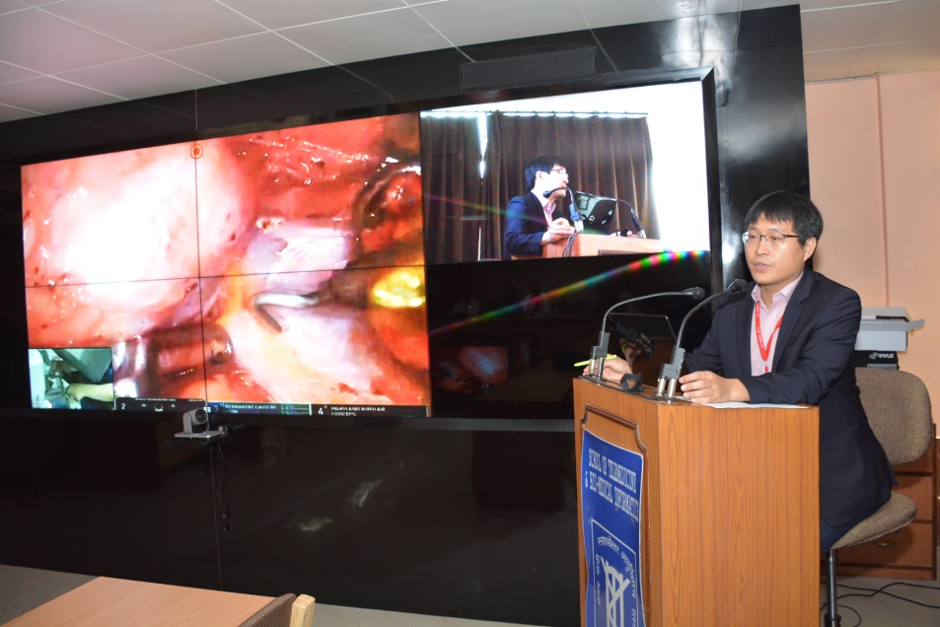
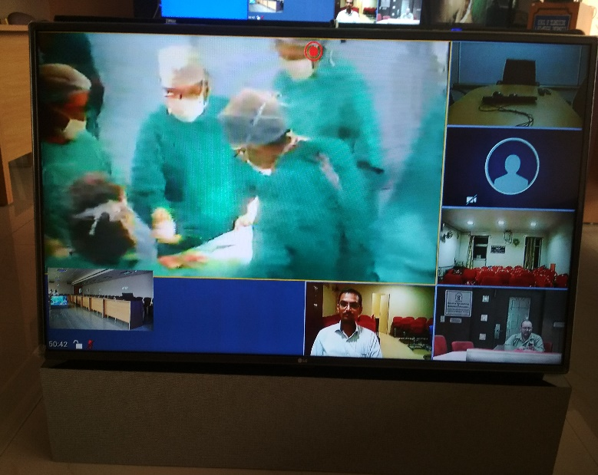
eTumour Board & Decision Support System (DSS)

Slide 20
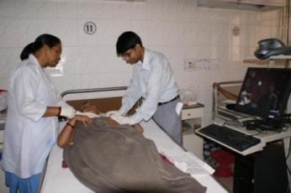
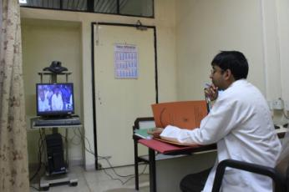
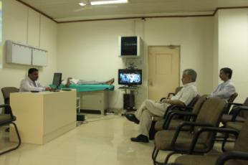
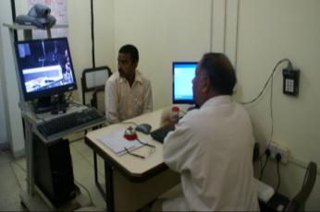
Mobile Telemedicine Kiosk (Operation using Hospital LAN)
Mobile kiosk @ Patient’s bedside
Doctor’s Duty Room
Department’s Seminar Room
Tele-Clinic in Out Patient Department

Slide 21
Mobile Telemedicine System

Slide 22
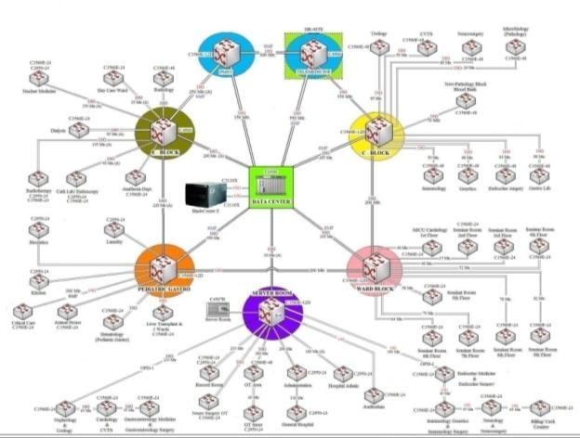
Intra-Hospital Telemedicine Network
Riding over Hospital Information System Network

Slide 23
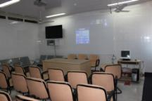
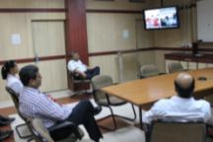
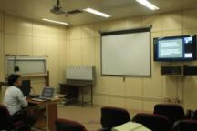
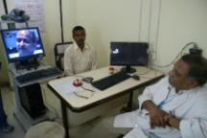
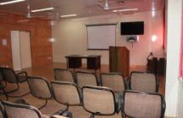
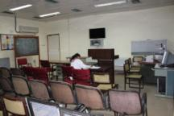
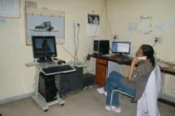
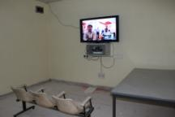
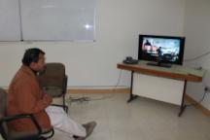
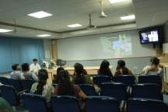
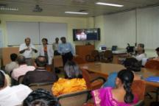
SGPGIMS Knowledge Network Enterprise
Nephrology
Endocrine Surgery
Radiology
Tele-Clinic
SGPGIMS
Telemedicine
HUB at
School of Telemedicine
&
Biomedical Informatics
(STBMI)
Neurology
Mobile Kiosk @ WARD
Nuclear Medicine
Mobile Kiosk @ Doctor’s Duty Room
OT Cafeteria
Immunology
Pathology
Radiotherapy

Slide 24
Knowledge Management Modules
Knowledge Portal
Tele CME
Tele-Surgery, Tele-Pathology, Tele-Radiology etc
Tele-Conference/ Workshop/ Seminar
Departmental Knowledge Content Storage & Archive
Clinical Decision Support System (CDSS)
Remote Assistance in Pre-intervention Plan & Intra-intervention Mentoring

Slide 25
Process
Scheduled Basis
Real Time & Interactive
Webcasting, Video on Demand
Web-Streaming
Webinar

Slide 26
SGPGI Knowledge Management SOP
Agreement with partner on schedule and content
Daily Testing with partners
Reminder a day before to all participating partners (Local & Remote)
Content Archival
User feedback - session wise for technical & content quality
Maintenance of the Log Book & Weekly review

Slide 27
Future Perspective of collaboration
Adoption of Advance technology for health professional education & training (Augmented / Virtual Reality / Simulations) leading to setting of skill labs
Clinical Artificial Intelligence, Machine Learning to assist Decision support system
Adoption of 5G Mobile Network for Rural Health Access
Building Satellite based Systems for Disaster Medicine and Prevention of infectious disease Epidemics
Biomedical Imaging Informatics Research

Slide 28
Conclusion
Knowledge engineering and technology infrastructure constitute one of the major component of Knowledge creation and it’s usage in an institutional set up
SGPGI case study aims at sharing the journey over a decade in developing knowledge management infrastructure which is still in progress
Provision of high internet bandwidth from NKN is facilitating the institution vision in knowledge sharing
As the infrastructure is getting ready in managing big data (medical image, skill videos, 3D animated contents for VR & simulation based learning, Avatar and games for health technology adoption for e-learning) high performance computing and network would be needed
Though cloud based e-learning technology is coming up in health domain, GRID is still needed for managing big data of medical educational content over an enterprise such as national medical college network

Slide 29
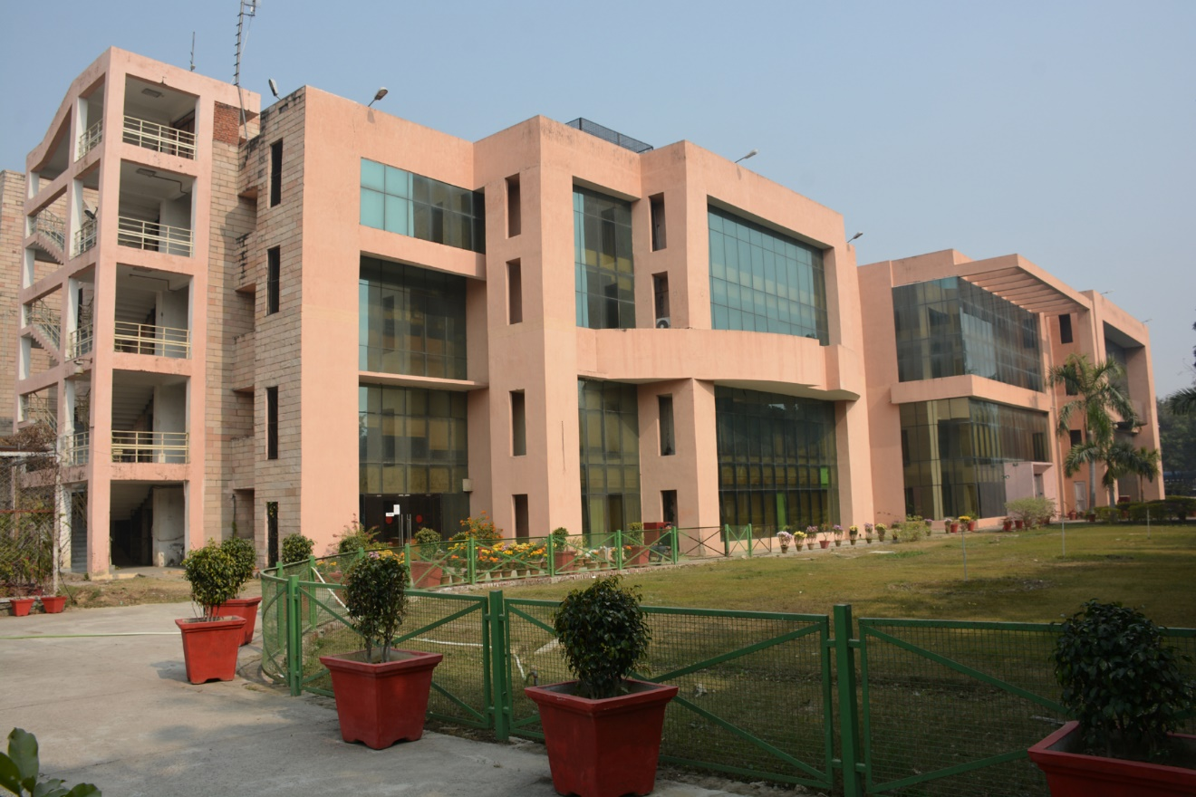
Thank You

